Slide 1
Chemistry: Physical properties
Year 7 Science

Slide 2
Preview
1 | Physical and chemical properties
2 | Solids, Liquid and Gases Properties Changing State
3 | Density
4 | Types of Mixtures Solutions and Solubility Separating Insoluble Substances Magnetic Gravity - Decanting Sieving Filtration Centrifuge | Solubility Investigation
5 | Separating Soluble Substances Chromatography Evaporating and Crystallisation Distillation | Chemistry 1 Test

Slide 3
Learning Intentions
Mixtures, including solutions, contain a combination of pure substances that can be separated using a range of techniques.

Slide 4
Success criteria
Explain what ‘property’ means in chemistry.
List physical properties of any substance.
Explain the difference between physical properties and chemical properties.

Slide 5
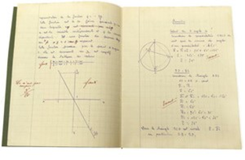
Properties of matter
All matter has physical and chemical properties. A property is a characteristic or feature of an object that distinguishes one substance from another.
Matter can be classified by its physical properties and chemical properties.
A physical property can be measured or observed without changing the identity of the substance.

Slide 6
Physical properties include:
colour
texture
hardness
odour
physical state
malleability
elasticity
electrical conductivity
magnetism
density
volatility
transparency
solubility
melting and boiling point
taste
12:35 PM

Slide 7
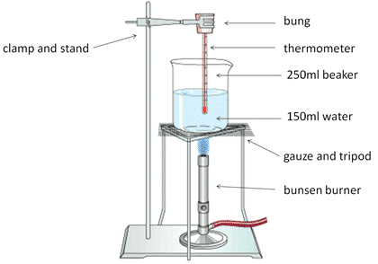
Activity: Melting point

Slide 8
Melting point of chocolate
Type of chocolate | Melting point (ºC)
White
Milk
Dark

Slide 9
Success criteria
Explain what ‘property’ means in chemistry.
List physical properties of any substance.
Explain the difference between physical properties and chemical properties.

